Slide 1
Source 1
Bedfordshire Archives Ref: Z1306/75/14/2

Slide 2
Source 2
Bedfordshire Archives Ref: Z1130/72/38

Slide 3
Source 3
Bedfordshire Archives Ref: Z1130/141

Slide 4
Source 4
Friday,11th June, 1943.
...somebody started scattering flower seeds over the shelters and at present they are a blaze of colour with all sorts of flowers– but mainly poppies—red, pink, white, striped, double and single. They are glorious and we stroll around at lunch time...These shelters are awful things and we used to spend hours in them when the sirens went…(now) we have our own “Spotters” on the roof and go down (willy-nilly) when they signal. If enemy planes are too near when they “spot” them, they sometimes give a “crash” warning when there is no time to go down the shelters and we have to get under desks or any other cover in the offices...
Bedfordshire Archives Ref: Z1606/3

Slide 5
Source 5 KS 4 and 5
Gaol Register: Thomas Wilkinson, 1872
Alias - “Joseph Powell”
Age – 19
Height - 5/4 ½
Hair – Sandy
Eyes – Grey
Complexion – pale
Visage – oval
Weight – 138 lbs
Trade – labourer
Where born – St Lukes, London
Last residence – 2 Norman Street, Old Street, St Lukes
Married or single – Single
Religion – Church of England
Read and write - IMP (imperfectly)
Marks and remarks – small cross on right forearm
Offence – Stealing from the person of one Susannah Robinson one railway ticket and one pound one shilling and nine pence in money at Luton on the 25th July 1872
Bedfordshire Archives Ref: QGV10/4/187

Slide 6
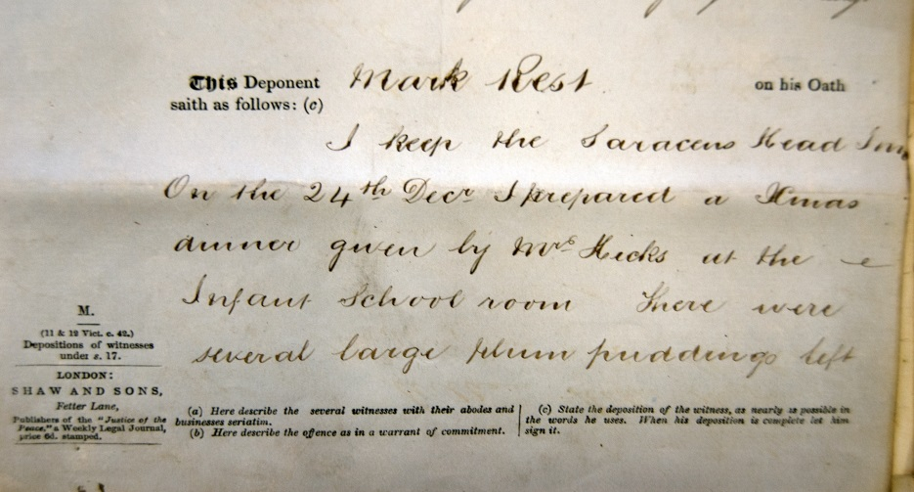
Source 6
Depositions and examination - Arthur Champkin charged with stealing one basin and one pudding from his master Mark Rest at Dunstable on 24 December 1874.
Mark Rest – he keeps the Saracens head Inn. On 24 December he prepared a Xmas dinner given by Mrs Hicks at the infant school room. There were several large plum puddings left. Champkin stood outside the school room while the dinner things were being taken away. He asked Champkin to help. Amongst other things he gave a pudding into Champkin’s hands. It had been given to him or his wife by Mrs Hicks. He left Champkin holding it up for the ostler in the cart to take. The ostler was busy putting the things into a basket as they were handed up. He went backwards and forwards into the schoolroom. In consequence of something he heard after he got home he sent for Champkin and asked what had become of the pudding. Champkin declared with an oath that he had not seen it at all. He asked Champkin to wait until he had sent for the charwoman. Champkin sat down, then got up again, said he was not going to waste his time and walked out. He followed him and sent his ostler for the police. Champkin turned abruptly out of the High Street down Church Alley, ran and turned into Church Street and then into Markham’s yard…
Bedfordshire Archives Ref: QSR1875/1/5/8

