Slide 1
Source 1
Bedfordshire Archives Ref: Z1306/1/32/1

Slide 2
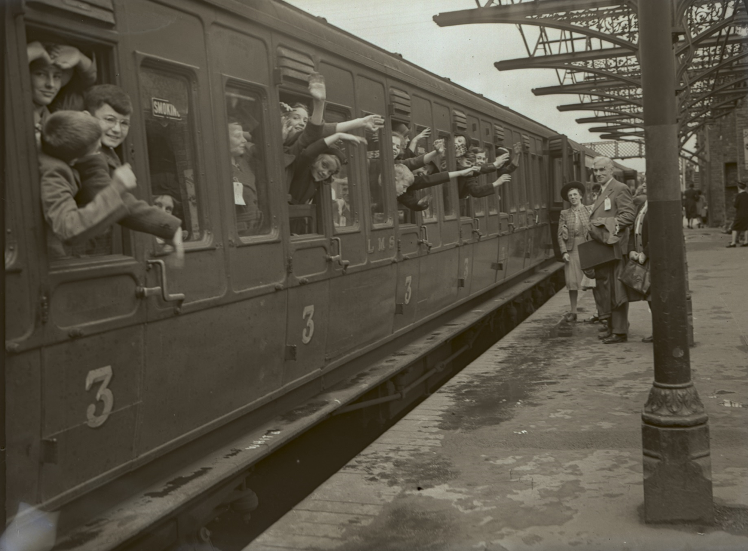
Source 2
Bedfordshire Archives Ref: BTNeg2104

Slide 3
Source 3
Bedfordshire Archives Ref: Z1306/83/8

Slide 4
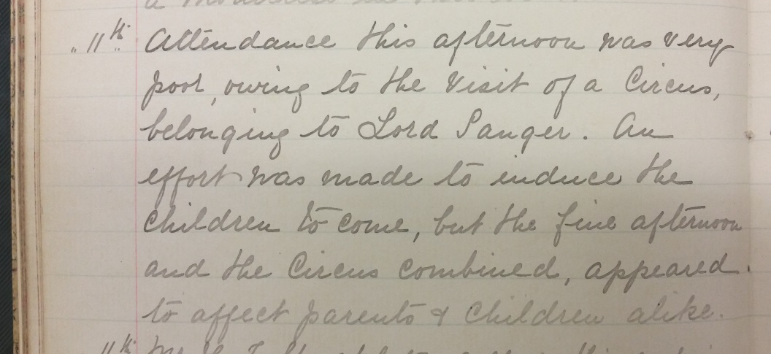
Source 4
Luton St Matthew’s School Log Book March 1898, recording the difficulty of encouraging students to attend school when the circus is in town.
11^{th.} Attendance this afternoon was very poor, owing to the visit of a Circus, belonging to Lord Sanger. An effort was made to induce the children to come, but the fine afternoon and the Circus combined, appeared to affect parents & children alike.
Bedfordshire Archives Ref: SDLutonSMTIn1/2

Slide 5
Source 5
Extract taken from a book of Ghost Stories
A third story was one that happened to Mrs. Piercey herself as a child – she lay in bed, and saw night after night two children running through the room at play, a boy and girl, the latter dressed in white – the boy called softly after the girl “Annie! Annie!” This happened several times, and when the little girl (the young Mrs. Piercey) told it to her elder brother, he resolved to stop it by setting a sort of trap for the ghosts.
Bedfordshire Archives Ref: OR2328-1a (Page 68)

Slide 6
Source 6
War Diary, 19 January 1916
2.am Morning Tactical Report (M.T.R)
…Enemy kept up persistent bombardment with trench mortars and rifle grenades until 11pm when they were silenced by our trench mortars and guns. Total casualty from Gas 13, 2 of whom have died. Gas casualties were greatly reduced by coolness of Cpl. Blanshard & Cpl. Ivory who entered mine shaft & removed all gassed men. Work is now being carried on cleaning damaged trenches. Wind S.SW.
2.45pm Evening Tactical Report (E.T.R)
…Morning quiet until 12 noon when our 4.5 guns commenced firing on German trench mortars on 79 trench. Work is being continued on clearing front trench round Matterhorn. Wind S.S.W. slight.
Bedfordshire Archives Ref: X550/8/1/1601

